Slide 1



Gillette Case Study
Supply Chain and Manufacturing Academy 2025
1

Slide 2




Meet The Team
Hussein Menshawy
Omar Moustafa
Mohamed Abdelsalam
Selim ElAhmady
2

Slide 3
Agenda
Problem Statement & Overview
Line 1 C:D Visibility
Line 2 C:D Visibility
IDE Reduction Plan
Forecasting Using AI & ML Techniques
3

Slide 4
Problem Statement
Phase out Product 1 by Aug-25, replace with Product 4 in Sep-25
Ensure smooth launch of Product 4
Minimize IDE costs (reduce scrap from Product 1 materials)
Maintain service levels for Products 2 & 3
4

Slide 5
Overview of Strategies
Ramping Up Production for Product 1 to fulfill high August Demand and burn through RM/PM
Discussing strategies to mitigate IDE for both FP and RM/PM
Leveraging AI techniques to forecast Future Demand
5

Slide 6
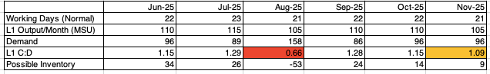
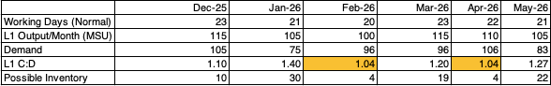
Line 1 Capacity-Demand Analysis
Key
Defected month
Inadequate buffer
Aim for C:D ≥1.1 to absorb ±10% demand variability.
Deficit Months: Aug-25(0.66)
At-risk months: Nov-26 (1.09), Feb-26 (1.04), Apr-26 (1.04).
6

Slide 7
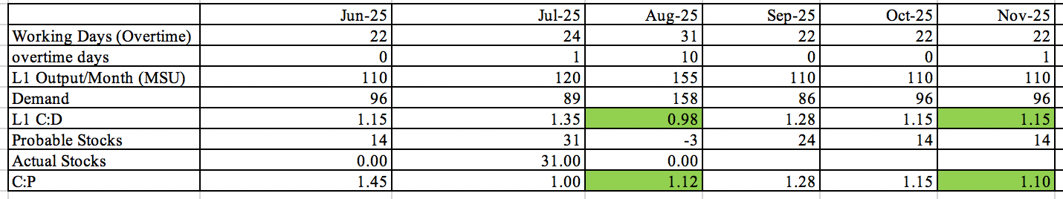
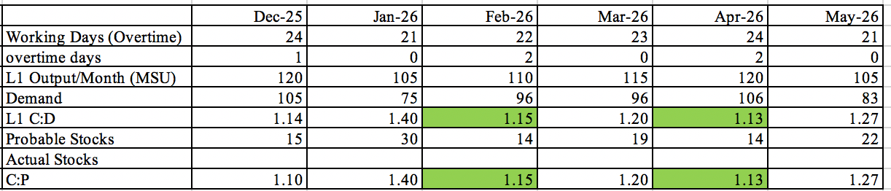
Line 1 Capacity-Demand Analysis
Key
Corrected Months
Main method to increase capacity is utilizing overtime
Meeting August Demand: Added limited overtime in July to pre-produce
Aggressive Overtime in August
The combined output (overtime + buffer) gives an effective C:D >1.1.
For other months with C:D <1.1 (e. g. Feb-26) the possibility of overtime was planned to increase C:D
7

Slide 8
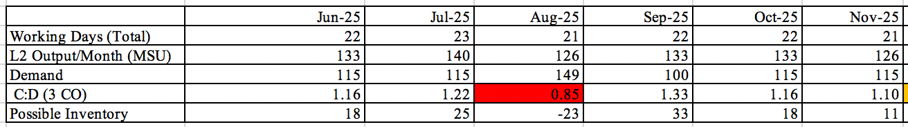
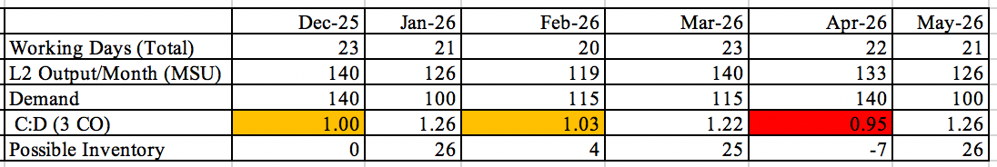
Line 2 Capacity-Demand Analysis
Key
Defected month
Inadequate buffer
3 Change over
Deficit month: August-25(0.85)
At risk months: Dec-25(1.00),Feb-26(1.03), Apr-26(0.95)
8

Slide 9
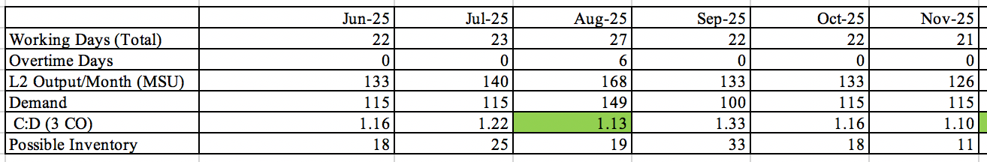
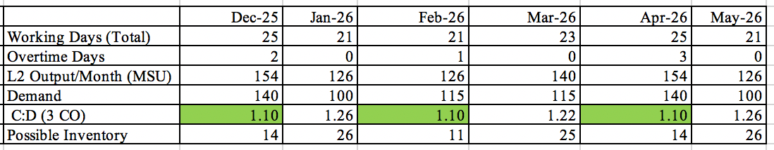
Line 2 Capacity-Demand Analysis
Key
Corrected months
Solution: Can use overtime if make all C:D above 1.1 to allow for buffer
Holding cash is not needed unlike in line one
9

Slide 10
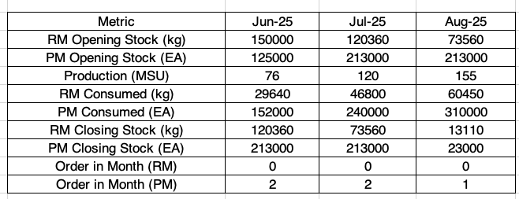
Line 1 Leftover IDE
RM Residual Stock (Aug-25):
13,110 kg → $72,105 cost
(Just <3% of yearly RM spend)
PM Residual Stock (Aug-25):
23,000 EA → $16,100 cost
(Just <1% of yearly PM spend)
10

Slide 11

IDE Reduction Plan For Finished Product
Explore opportunities to supply Product 1 to neighboring countries where it is still being sold.
Identify alternative markets, such as Market D, to sell the product at a reduced cost
Donate products to events as a means of promoting and raising awareness for Gillette’s brand
Distribute remaining inventory to employees
Dispose of remaining inventory through scrapping
11

Slide 12
IDE Reduction Plan For RM
Negotiate with the supplier to lower the minimum order quantity (MOQ) at the outset
Return excess raw materials to the supplier at a negotiated discounted price
Sell excess raw materials, such as gel, separately in the market
Dispose of remaining inventory through scrapping
12

Slide 13
IDE Reduction Plan For PM
Will have to Dispose of remaining inventory through scrapping
Cant use for other products
Has P&G and Gillette logos so can not return to supplier
13

Slide 14


Forecasting Using AI
Limited Data Approach:
Implement the “Prophet” package in R ---> Robust & Effective for short Time-Series
Promotional Weeks, Scheduled Price Increases, & Product 4 Launch
Large Dataset Approach:
Daily Demand Data --> Make Weekly Forecasts
Apply ML models (e.g., Random Forests) to find non-linear relationships between variables
Leads to enhanced model interpretability and detection of seasonality and trends
14

Slide 15

Forecasting Using AI (cont.)
Forecast-Enhancing Data Signals:
Promotional Periods: Capture demand spikes
Scheduled Price Increases: Stepped adjustments
2% increase in Jan. 2026
3% increase in June 2026
Product 4 Launch: 5% uplift starting Sept. 2025
Assessing Forecast Reliability:
Scenario Simulation: Comparing outcomes from the different Data Signals
15

Slide 16
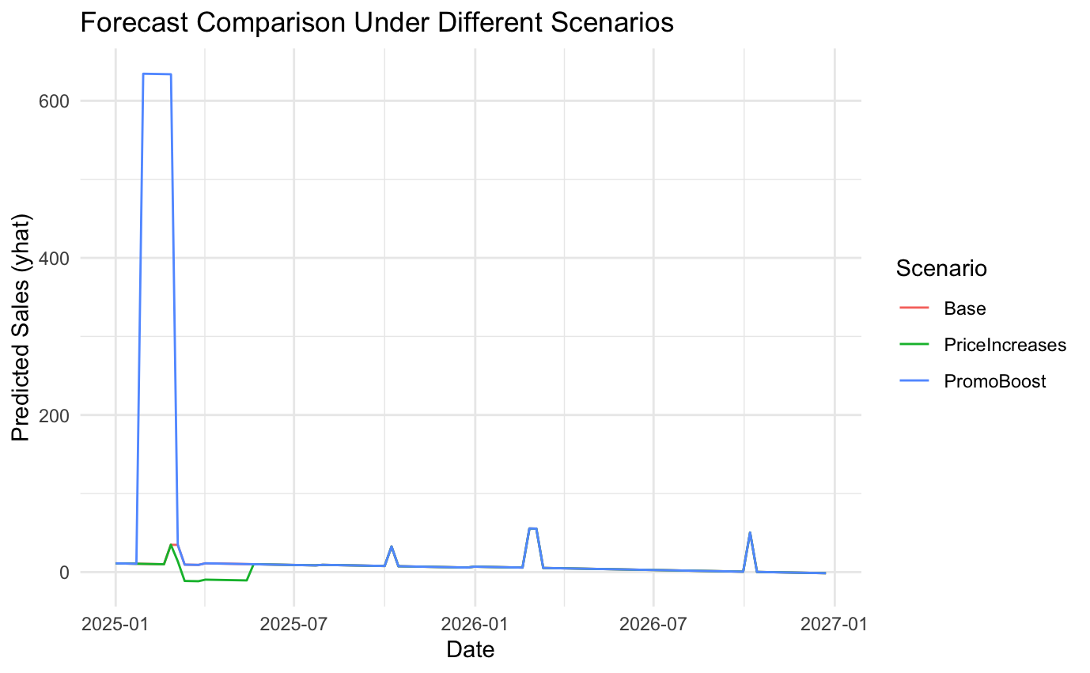
Pilot Model
16

Slide 17
How can we further enhance our forecast?
By implementing a new data signal called “AI Sensors”
17

Slide 18
What is FMOT?
The “First Moment of Truth” (FMOT), coined by P&G, refers to the critical 3–7 seconds when a consumer first sees a product and decides whether to buy it or not.
Key Points about FMOT:
Happens after the stimulus (like an ad) & before purchasing.
When packaging, price, branding, & shelf placement play a critical role.
18

Slide 19
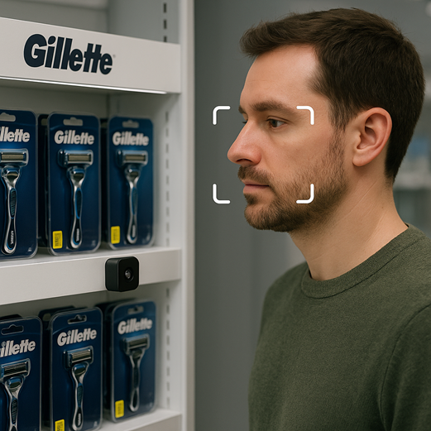

Ways to Improve Using AI
Using sensors like the iPhone Face-ID at the market shelf to generate immediate responses while the customer is buying new products (Blurred)
Expected Model for the Idea
19

